Slide 1
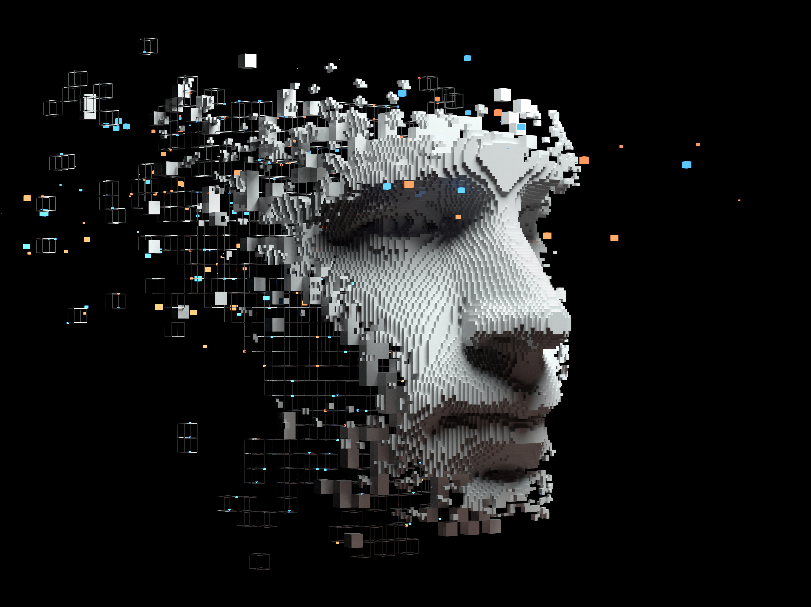
Diagnostic Model using Neuroimages for Stroke Identification A Machine Learning Approach
Under The Guidance of Project coordinator Hod-CSE(AI&ML)
Mrs.Satya Sudha Mrs. G.Sri Sudha Dr.S.Kavitha
Assistant Professor Assistant Professor Associate Professor
Ayushman Sharma – 21AG1A6669
Preetham Reddy – 21AG1A6667
K. Roja – 21AG1A6687

Slide 2

Abstract
Stroke is a serious medical condition that requires timely and accurate diagnosis to improve patient outcomes.
Stroke identification involves detecting the stroke from dataset and classifying stroke types from neuroimages. Strokes can be ischemic (caused by blood clots) or hemorrhagic (caused by bleeding). This project aims to develop a machine learning model for detection of stroke as well as identify and classify strokes using neuroimages such as MRI and CT scans. The process involves collecting neuroimaging data, preprocessing the images, and extracting relevant features. Various machine learning algorithms, particularly convolutional neural networks (CNNs), are trained to recognize patterns in the images that indicate different types of strokes. The model is evaluated using metrics like accuracy and precision to ensure its reliability. Ultimately, the goal is to create a system that can assist healthcare professionals in diagnosing strokes quickly and accurately, potentially improving treatment decisions and patient care. Early and accurate detection is crucial for effective treatment.

Slide 3
Introduction
Background: Stroke is a leading cause of death and long-term disability worldwide, affecting millions annually. It can lead to severe neurological damage if not treated promptly. Accurate early diagnosis is crucial for successful treatment.
Objective: To design a machine learning model that can identify and classify different types of strokes, assisting doctors in quick diagnosis.
Importance: Stroke diagnosis involves complex neuroimaging techniques. Our model automates and enhances this process, helping healthcare professionals make better treatment decisions, thus potentially improving patient recovery times and reducing fatalities.

Slide 4

Literature Survey: Scope of Review
This literature review examines key studies related to stroke diagnosis using neuroimages and machine learning models. It focuses on methods for neuroimage analysis, machine learning techniques applied in stroke detection, and limitations in existing research. The review serves as the foundation for developing a more efficient and accurate stroke identification model.

Slide 5
Literature Survey: Key Studies and Methodologies
Several studies have demonstrated the use of machine learning models, particularly convolutional neural networks (CNNs), in analyzing neuroimages for stroke diagnosis.
These studies demonstrate the potential of machine learning in stroke diagnosis, but there are still gaps in data diversity and generalization.
Paper Title | Author Name | Proposed Methodology | Findings
An integrated machine learning approach to stroke prediction | A. Khosla, Y. Cao, C. C.-Y. Lin, H.-K. Chiu, J. Hu, H. Lee | Used an integrated approach combining multiple machine learning models for stroke prediction. | Machine learning models were able to significantly improve stroke prediction accuracy over traditional methods.
Stroke risk prediction using machine learning: A prospective cohort study of 0.5 million Chinese adults | M. Chun, R. Clarke, B. J. Cairns, D. Clifton, D. Bennett, Y. Chen, Y. Guo, et al. | Machine learning models were applied to a large cohort dataset, utilizing data such as age, lifestyle factors, and medical history. | The model provided high accuracy in predicting stroke risk, identifying age and lifestyle factors as significant contributors.

Slide 6
Paper Title | Author Name | Proposed Methodology | Findings
Conventional and deep learning methods for skull stripping in brain MRI | Conventional and deep learning me | Investigated the cellular mechanism ferroptosis and its role in stroke progression. | Identified ferroptosis as a key mechanism in stroke, opening avenues for therapeutic interventions aimed at reducing ferroptotic cell death during strokes.
A predictive analytics approach for stroke prediction using machine learning and neural networks | S. Dev, H. Wang, C. S. Nwosu, N. Jain, B. Veeravalli, D. John | Combined medical big data with machine learning algorithms, specifically targeting hypertensive patients to predict stroke risk. | The model provided a significant improvement in predicting stroke for hypertensive patients, highlighting hypertension as a critical risk factor for strokes.
Paper Title | Author Name | Proposed Methodology | Findings
Deep learning-enabled brain stroke classification on computed tomography images | A. Tursynova, B. Omarov, N. Tukenova, I. Salgozha, O. Khaaval, R. Ramazanov, B. Ospanov | Developed a machine learning model to stratify cardiovascular risk in ischemic stroke patients. | The model effectively stratified cardiovascular risk, providing personalized risk assessments for better clinical decision-making in ischemic stroke cases.
Predicting brain stroke using IoT-enabled deep learning and machine learning: Advancing sustainable healthcare | M. Gupta, P. Meghana, K. H. Reddy, P. Supraja | Applied predictive analytics and neural networks to develop a model for stroke prediction based on historical health data. | Achieved high predictive accuracy in stroke prediction using neural networks, with health history playing a pivotal role in model success.

Slide 7
Literature Survey: Gaps in Existing Research
Despite the progress made in using machine learning models for stroke diagnosis, several challenges remain:
- Limited availability of diverse and large-scale datasets, particularly from different demographic backgrounds.
- High variability in neuroimage quality, making it difficult for models to generalize.
- Lack of real-time diagnostic systems integrating neuroimage analysis with clinical data for comprehensive stroke detection.

Slide 8
Literature Survey: Addressing Research Gaps
Our project addresses these gaps by:
- Utilizing multiple datasets from different institutions to increase data diversity and improve model generalization.
- Applying advanced data augmentation and image enhancement techniques to handle variability in neuroimage quality.
- Developing a real-time diagnostic tool that integrates neuroimage analysis with clinical data for comprehensive stroke diagnosis.

Slide 9

Hardware and Software Requirements
**Hardware**:
- GPU-enabled system for training (e.g., NVIDIA GTX 1080 or higher)
- RAM (16GB or higher)
**Software**:
- Python 3.x
- TensorFlow, Keras, PyTorch
- SimpleITK, nibabel for neuroimage processing
- Jupyter Notebook, Google Colab
- Operating System: Linux/Windows

Slide 10
Literature Survey: Conclusion
In conclusion, our project introduces several innovations in stroke diagnosis using neuroimages. By leveraging advanced CNN techniques and larger, more diverse datasets, our approach improves both accuracy and generalizability.
Furthermore, integrating clinical data with neuroimage analysis provides a holistic diagnostic tool that surpasses current methods, making it highly valuable for real-time stroke identification in healthcare settings.

Slide 11

THANK YOU.

